Slide 1
CS 699 Project Report
Telecom Users Dataset
Yung-Chieh Yang

Slide 2

Data Mining Goal:
The task is to analyze the data and predict user churn (to determine who will and will not renew the contract).

Slide 3
Why predict user churn?
Any business wants to maximize the number of customers. In order to achieve this goal, it is important not only to try to attract newcomers, but also to retain existing ones. Compared with attracting new customers, the cost of retaining customers will reduce the company's costs. In addition, new customers may have weak interest in business services and it is difficult to work with them, while old customers already have the data needed to interact with the service. Therefore, by predicting churn, we can react in a timely manner and try to keep customers who want to leave.

Slide 4
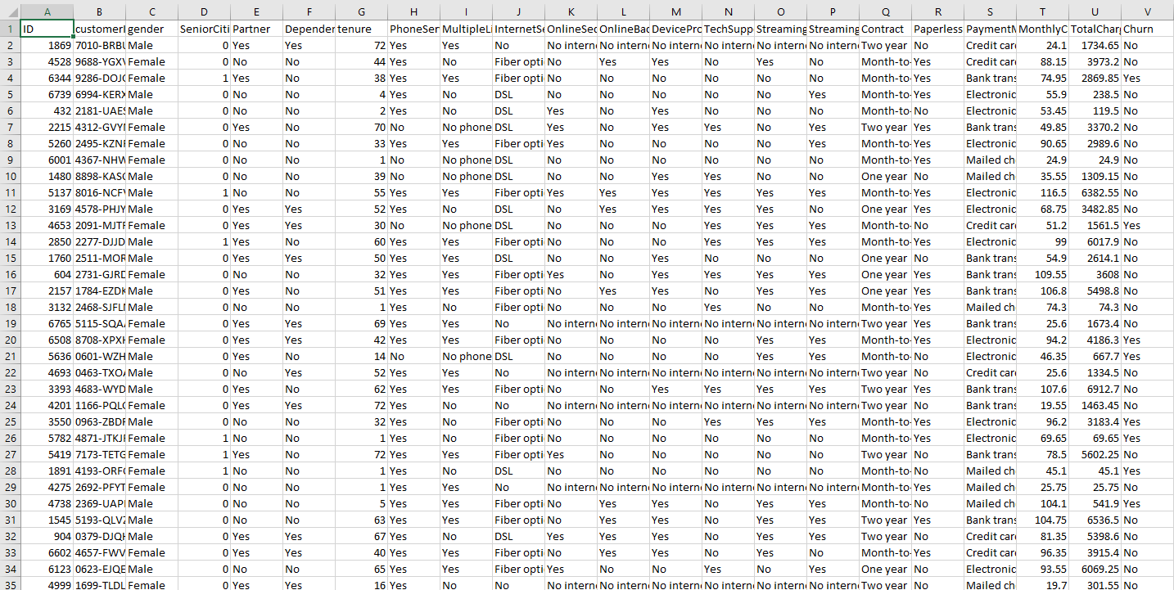
Detailed Description of the Dataset
This dataset has 22 attributes and 5986 tuples.

Slide 5
Detailed Description of the Dataset
ID - ID of the tuple
customerID – customer id
gender – client gender (male/female)
SeniorCitizen – is the client retired (Yes, No)
Partner - is the client married (Yes, No)
Dependents – is the client has dependents (Yes, No)
tenure - how many months a person has been a client of the company
PhoneService - is the telephone service connected (Yes, No)
MultipleLines - are multiple phone lines connected (Yes, No, No phone service)
InternetService - client's Internet service provider (DSL, Fiber optic, No)
OnlineSecurity - is the online security service connected (Yes, No, No internet service)
OnlineBackup - is the online backup service activated (Yes, No, No internet service)

Slide 6
Detailed Description of the Dataset
DeviceProtection - does the client have equipment insurance (Yes, No, No internet service)
TechSupport - is the technical support service connected (Yes, No, No internet service)
StreamingTV - is the streaming TV service connected (Yes, No, No internet service)
StreamingMovies - is the streaming cinema service activated (Yes, No, No internet service)
Contract - type of customer contract (Month-to-month, One year, Two year)
PaperlessBilling - whether the client uses paperless billing (Yes, No)
PaymentMethod - payment method (Electronic check, Mailed check, Bank transfer (automatic), Credit card (automatic))
MonthlyCharges - current monthly payment
TotalCharges - the total amount that the client paid for the services for the entire time
Churn - whether there was a churn (Yes or No)

Slide 7
Data Mining Tools
Weka and JMP Pro
Test classification model using 10-fold cross-validation in Weka;
Five attribution selection methods in Weka;
Build classification models in JMP Pro.

Slide 8
5 Classification Algorithms
Naïve Bayes Classification
K-nearest Neighbors Classification
Neural Network Classification
Partition Model Classification (Decision Tree)
Boosted Tree Classification

Slide 9
5 Attribute Selection Methods
BestFirst + CfsSubsetEval
Ranker + CorrelationAttributeEval
Ranker + GainRatioAttributeEval
Ranker + InfoGainAttributeEval
Ranker + ReliefAttributeEval

Slide 10
5 Sets of Attributes Selected by Each Attribute Selection Method
CfsSubsetEval | CorrelationAttributeEval | GainRatioAttributeEval | InfoGainAttributeEval | ReliefAttributeEval
Tenure OnlineSecurity TechSupport Contract PaymentMethod | Tenure OnlineSecurity TechSupport Contract InternetService | OnlineBackup OnlineSecurity TechSupport Contract InternetService | Tenure OnlineSecurity TechSupport Contract InternetService | Tenure MultipleLines PaymentMethod Contract InternetService

Slide 11
Data Mining Procedure
Preprocessing: remove 2 attributes – ID and customerID when building classification models
Test 5 classification models using 10-fold cross-validation in Weka
 | TP Rate | FP Rate | Precision | Recall | F-Measure | MCC | ROC Area | PRC Area
J48/Partition Model | 0.775 | 0.424 | 0.761 | 0.775 | 0.765 | 0.383 | 0.756 | 0.760
K-nearest Neighbors | 0.711 | 0.429 | 0.718 | 0.711 | 0.714 | 0.276 | 0.646 | 0.689
Naïve Bayes | 0.725 | 0.231 | 0.793 | 0.725 | 0.740 | 0.439 | 0.815 | 0.835
Neural Network | 0.756 | 0.377 | 0.757 | 0.756 | 0.756 | 0.377 | 0.792 | 0.815
Boosted Tree | 0.785 | 0.417 | 0.772 | 0.785 | 0.774 | 0.408 | 0.821 | 0.842

Slide 12
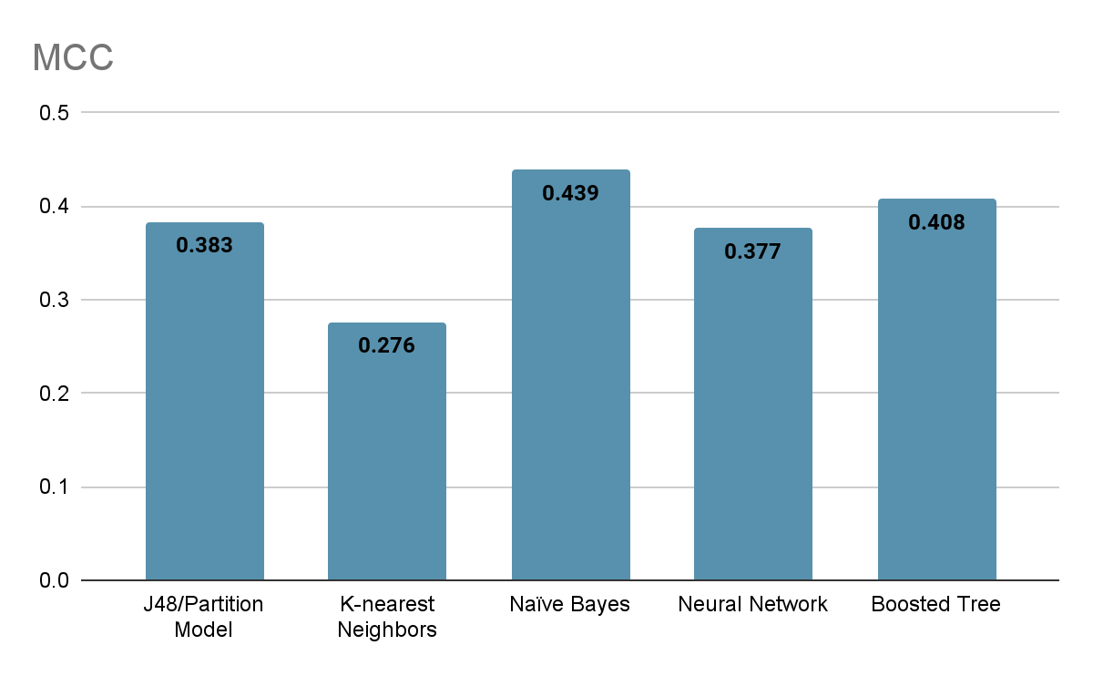
Data Mining Procedure
Matthews Correlation Coefficients of 5 classification models using 10-fold cross-validation

Slide 13
Build 5 Classification Models
(Weighted Average)
 | TP Rate | FP Rate | Precision | Recall | F-Measure | MCC
J48/Partition Model | 0.7106 | 0.2893 | 0.6551 | 0.7106 | 0.6711 | 0.3615
K-nearest Neighbors | 0.6997 | 0.3003 | 0.7010 | 0.6997 | 0.7003 | 0.4007
Naïve Bayes | 0.6782 | 0.3217 | 0.7300 | 0.6782 | 0.6789 | 0.4050
Neural Network | 0.7269 | 0.2731 | 0.7086 | 0.7269 | 0.7165 | 0.4352
Boosted Tree | 0.7377 | 0.2622 | 0.6961 | 0.7377 | 0.7112 | 0.4391

Slide 14
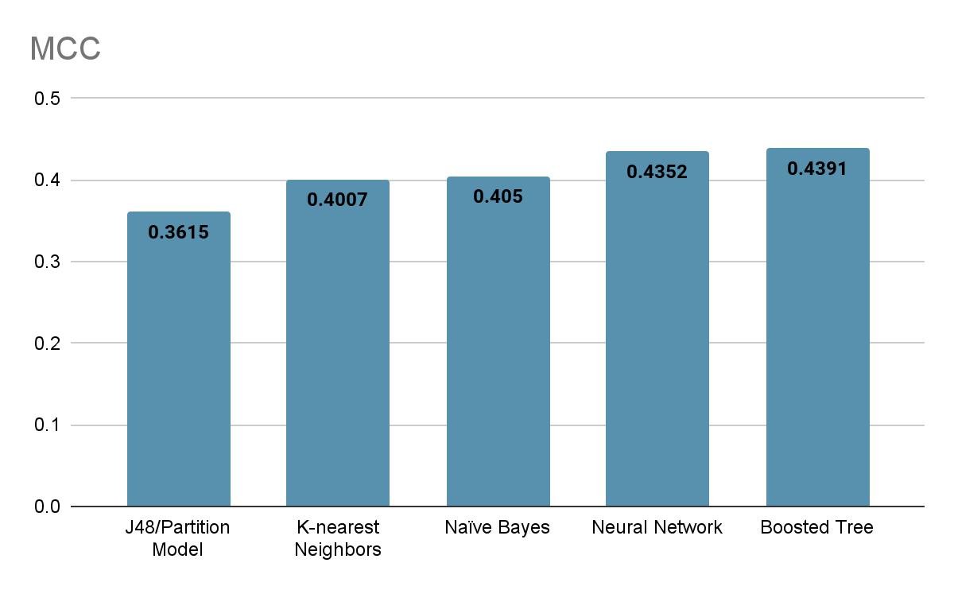
Data Mining Procedure
Matthews Correlation Coefficients of 5 classification models

Slide 15
Data Mining Procedure
Matthews Correlation Coefficients of 5 sets of attributes in five classification models (Total 25 Classification Models)
 | CfsSubsetEva | CorrelationAttributeEval | GainRatioAttributeEval | InfoGainAttributeEval | ReliefAttributeEval | OriginalModel | 10-fold cross-validation
Naïve Bayes | 0.4202 | 0.4186 | 0.4088 | 0.4186 | 0.4348 | 0.4050 | 0.4390
K-nearest Neighbors | 0.3330 | 0.3671 | 0.3224 | 0.3714 | 0.4023 | 0.4007 | 0.2760
Neural Network | 0.3982 | 0.4190 | 0.3692 | 0.4287 | 0.4244 | 0.4352 | 0.3770
J48/Partition Model | 0.3615 | 0.3615 | 0.3881 | 0.3615 | 0.3807 | 0.3615 | 0.3830
Boosted Tree | 0.3801 | 0.4163 | 0.3692 | 0.4163 | 0.4201 | 0.4319 | 0.4080

Slide 16
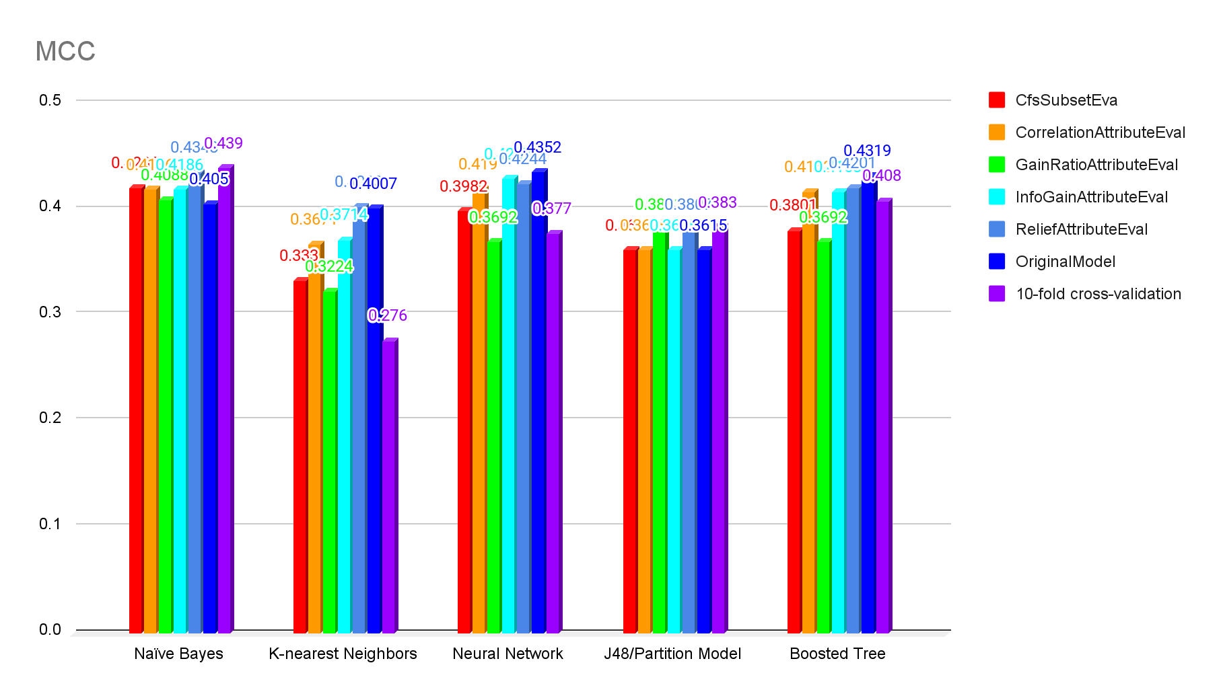
Data Mining Procedure
Matthews Correlation Coefficients of 5 sets of attributes in five classification models (Total 25 Classification Models)

Slide 17

Discussion
and
Conclusion
When using Naïve Bayes Classification, Ranker + ReliefAttributeEval has better prediction.
When using K-nearest Neighbors Classification, Ranker + ReliefAttributeEval has better prediction.
When using Neural Network Classification, Ranker + InfoGainAttributeEval has better prediction.
When using Partition Model Classification (Decision Tree), Ranker + GainRatioAttributeEval has better prediction.
When using Boosted Tree Classification, Ranker + ReliefAttributeEval has better prediction.

Slide 18

Discussion
and
Conclusion
Overall, Naïve Bayes Classification with Ranker + ReliefAttributeEval has the best prediction.
Set of Attributes: Contract, PaymentMethod, tenure, InternetService, MultipleLines

Slide 19

THE END
Questions ?

